Slide 1


About the Presentations
The presentations cover the objectives found in the opening of each chapter.
All chapter objectives are listed in the beginning of each presentation.
You may customize the presentations to fit your class needs.
Some figures from the chapters are included. A complete set of images from the book can be found on the Instructor Resources disc.

Slide 2
INTRODUCTION
Tom Hopkins
Office Hours: 9-10 Tues-Thurs, 12-3 MW
2:30-3:30 Tues, Wed, &Thurs
Phone: 678-6239 or Cell 347-6105
Email: Thopkins@bpcc.edu

Slide 3
Introduction
Class: Attendance
Quiz and Assignments: Blackboard
CIW online course

Slide 4
JavaScript, Fifth Edition
Chapter 1
Introduction to JavaScript

Slide 5
Objectives
In this chapter, you will:
Study the history of the World Wide Web
Learn about Web development
Add basic JavaScript code to your Web pages
Learn about the JavaScript programming language
Add structure to your JavaScript programs
JavaScript, Fifth Edition

Slide 6
Introduction to the World Wide Web
1962: memos by J. C. R. Licklider
1960s: ARPANET
  First Internet implementation
  Developed by Advanced Research Projects Agency (ARPA): U.S. Department of Defense
1990 and 1991: World Wide Web (Web)
  Created by Tim Berners-Lee
  Hypertext linking
    Method of accessing cross-referenced documents
JavaScript, Fifth Edition

Slide 7
Introduction to the World Wide Web (cont’d.)
“Web” and “Internet”
  Not synonymous
Hypertext link or hyperlink
  Reference to a specific Web page: click to open page
Web page
  Document on the Web
  Identified by the Uniform Resource Locator (URL)
    Unique Web address
Uniform Resource Identifier (URI)
  Many types of names and addresses on the Web
JavaScript, Fifth Edition

Slide 8
Introduction to the World Wide Web (cont’d.)
Web site
  Location on the Internet
    Contains Web pages and related files belonging to a company, organization, individual
Web browser
  Program displaying Web page on the screen
Web server
  Computer delivering Web pages
    Handles requests
    Provides responses
JavaScript, Fifth Edition

Slide 9
Understanding Web Browsers
NCSA Mosaic
  1993: created at the University of Illinois
  Allowed Web navigation using a graphical user interface (GUI)
Netscape Navigator
  1994: released by Netscape
  Soon controlled 75% of the market
Microsoft Internet Explorer
  1996: released by Microsoft
JavaScript, Fifth Edition

Slide 10
Understanding Web Browsers (cont’d.)
Browser wars began over DHTML (Dynamic HTML)
  Forced Web industry to rapidly develop and adopt advanced Web page standards
1994: World Wide Web Consortium (W3C) established
  Oversee Web technology standards development
  Adopted Internet Explorer version four DHTML
    Loyal Netscape followers defected to Microsoft
Firefox (open source)
  Now controls approximately 22.5% of the browser market. IE about 52.5%
JavaScript, Fifth Edition

Slide 11
Creating Web Pages
Hypertext Markup Language (HTML)
  Markup language
    Set of characters or symbols defining a document’s logical structure
  Based on an older Standard Generalized Markup Language (SGML)
JavaScript, Fifth Edition

Slide 12
Basic HTML Syntax
Tags: formatting instructions
  Determines how data displayed on a Web page
Element: tag pair and any data it contains
  Element content: information contained in element’s opening and closing tags
  Empty elements: do not require a closing tag
Root element: contains all other elements in a document
  <head> element: information used by the browser
  Document body: <body> element and the text and elements it contains
JavaScript, Fifth Edition

Slide 13
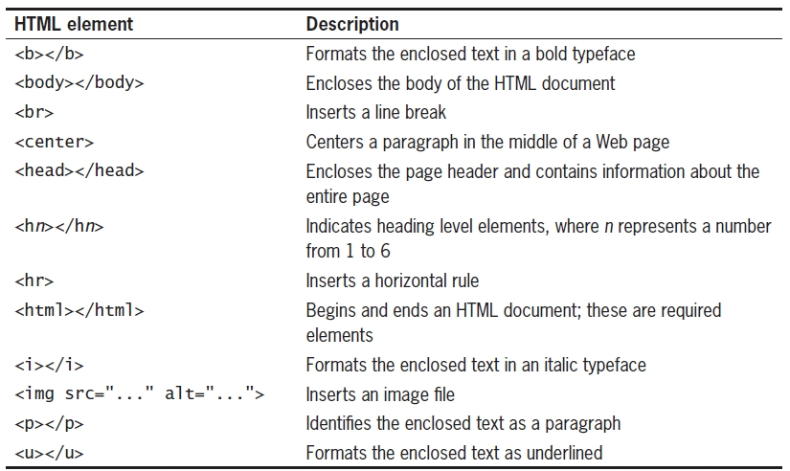
Basic HTML Syntax (cont’d.)
Table 1-1 Common HTML elements
JavaScript, Fifth Edition

Slide 14
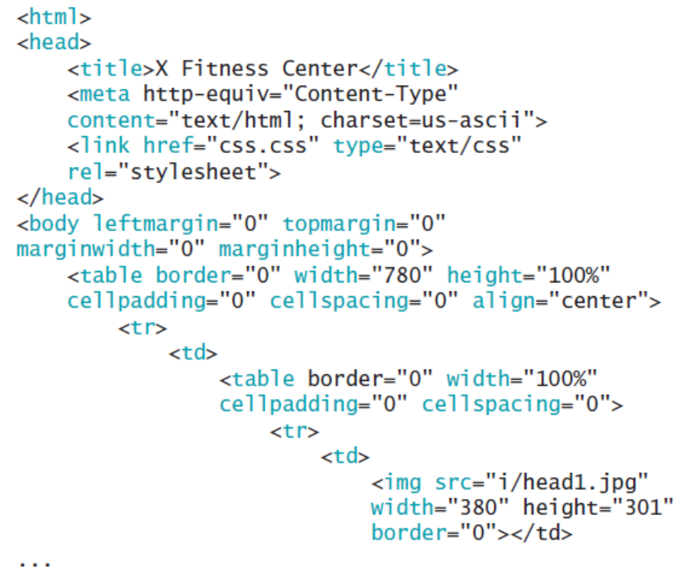
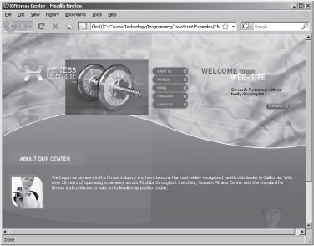
Basic HTML Syntax (cont’d.)
Figure 1-1 Fitness Center Web
page
JavaScript, Fifth Edition

Slide 15
Creating an HTML Document
Text editors: Notepad or WordPad
  Word-processing applications
    Capable of creating simple text files
HTML editors: Adobe Dreamweaver and Microsoft Expression Web
  Graphical interfaces allowing immediate view of the results
  Automates process of applying elements
    May add many unfamiliar elements and attributes to documents
JavaScript, Fifth Edition

Slide 16
Working with XHTML and Well-Formed
Web Pages
Extensible Hypertext Markup Language (XHTML)
  Next generation markup language for creating Web pages but 2012- being replaced by HTML5
User agent
  Application retrieving and processing HTML and XHTML documents
  Cannot process HTML elements handling data display and formatting
  Examples: mobile phones and PDAs
JavaScript, Fifth Edition

Slide 17
Introduction to Web Development
Web page design (Web design)
  Visual design and creation of documents appearing on the World Wide Web
Web page authoring (Web authoring)
  Creation and assembly of the tags, attributes, data making up a Web page
Web development or Web programming
  Design of software applications for a Web site
Web browsers contain commands to view underlying HTML code
  Only view to improve skills
JavaScript, Fifth Edition

Slide 18
Understanding Client/Server Architecture
Two-tier system
  Client and server
Server or back end
  Usually a database: client requests information
Client or front end
  Responsible for user interface
  Gathers information from user
    Submits information to server
    Receives, formats, presents results returned from the server
JavaScript, Fifth Edition

Slide 19
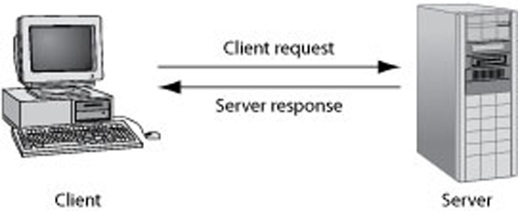
Understanding Client/Server Architecture (cont’d.)
Figure 1-3 The design of a two-tier client/server system
Web built on a two-tier client/server system
  Requests and responses through which a Web browser and Web server communicate happen with HTTP
JavaScript, Fifth Edition

Slide 20
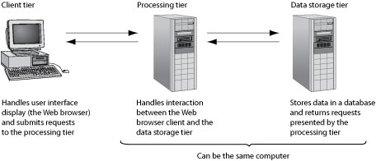
Understanding Client/Server Architecture (cont’d.)
Figure 1-4 The design of a three-tier client/server system
Three-tier, multitier, client/server system
  Client tier
  Processing tier
  Data storage tier
JavaScript, Fifth Edition

Slide 21
JavaScript and Client-Side Scripting
Static Web pages
  Cannot change after browser renders them
HTML and XHTML produced static documents
JavaScript
  Allows Web page authors to develop interactive Web pages and sites
  Client-side scripting language: runs on local browser
Scripting engine executes scripting language code
Scripting host
  Web browser containing scripting engine
JavaScript, Fifth Edition

Slide 22
JavaScript and Client-Side Scripting (cont’d.)
JavaScript history
  First introduced in Navigator (LiveScript)
  Navigator 2.0: name changed to JavaScript 1.0
  Microsoft released Internet Explorer 4.0 version of JavaScript (Jscript)
ECMAScript
  International, standardized version of JavaScript
  Most recent version: edition 3
JavaScript, Fifth Edition

Slide 23
JavaScript and Client-Side Scripting (cont’d.)
Limitations of JavaScript
  Cannot be used outside the Web browser
  No mechanism for creating a network connection or accessing a database
  Cannot run system commands or execute programs on a client
JavaScript, Fifth Edition

Slide 24
Understanding Server-Side Scripting
Server-side scripting
  Scripting language executed from a Web server
  Popular languages: PHP, ASP, JSP
Can develop interactive Web sites to communicate with a database
Server-side scripting language limitations
  Cannot access or manipulate a Web browser
  Cannot run on a client tier
JavaScript, Fifth Edition

Slide 25
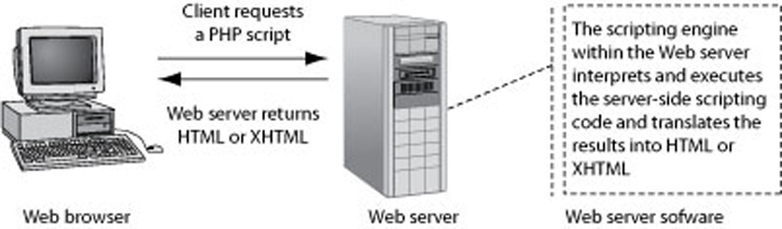
Understanding Server-Side Scripting (cont’d.)
Figure 1-5 How a Web server processes a server-side script
JavaScript, Fifth Edition

Slide 26
Should You Use Client-Side or Server-Side Scripting?
General rule of thumb
  Allow client to handle user interface processing and light processing (data validation)
  Have the Web server perform intensive calculations and data storage
Important to perform as much processing as possible on the client
JavaScript, Fifth Edition

Slide 27
Adding JavaScript to Your Web Pages
Basic procedures
  Used for adding JavaScript to Web pages
JavaScript, Fifth Edition

Slide 28
Using the <script> Element
Scripts
  JavaScript programs contained within a Web page
<script> element
  Tells the browser that the scripting engine must interpret the commands it contains
  Type attribute
    Tells the browser which scripting language and which version of the scripting language being used
JavaScript, Fifth Edition

Slide 29
Understanding JavaScript Objects
Object
  Programming code and data
    Treated as an individual unit or component
Procedures
  Individual statements used in a computer program grouped into logical units
  Used to perform specific tasks
Methods
  Procedures associated with an object
JavaScript, Fifth Edition

Slide 30
Understanding JavaScript Objects (cont’d.)
Property
  Piece of data associated with an object
  Assign value to a property using an equal sign
Argument
  Information that must be provided to a method
Passing arguments
  Providing an argument for a method
JavaScript, Fifth Edition

Slide 31
Using the write() and writeln()
Methods
Document object
  Represents content of a browser’s window
Create new Web page text with the write() method or the writeln() method of the Document object
  Both methods require a text string as an argument
  Text string or literal string
    Text contained within double or single quotation marks
writeln() method adds a line break after the line of text
JavaScript, Fifth Edition

Slide 32
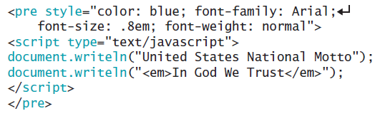
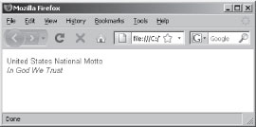
Using the write() and writeln()
Methods (cont’d.)
Figure 1-6 Output of a script that uses the writeln() method of the Document object
JavaScript, Fifth Edition

Slide 33
Case Sensitivity in JavaScript
JavaScript is case sensitive
Within JavaScript code:
  Object names must always be all lowercase
JavaScript, Fifth Edition

Slide 34
Adding Comments to a JavaScript Program
Comments
  Nonprinting lines placed in code containing various types of remarks
Line comment
  Hides a single line of code
  Add two slashes // before the comment text
Block comments
  Hide multiple lines of code
  Add /* before the first character included in the block and */ after the last character in the block
JavaScript, Fifth Edition

Slide 35
Writing Basic JavaScript Code
Learn how to write basic JavaScript code
  Start with variables
JavaScript, Fifth Edition

Slide 36
Using Variables
Variables
  Values a program stores in computer memory
Assigning a value to a variable
  Same as storing a value in a variable
JavaScript, Fifth Edition

Slide 37
Assigning Variable Names
Identifier
  Name assigned to a variable
  Rules and conventions
    Must begin with an uppercase or lowercase ASCII letter, dollar sign ($), or underscore ( _ )
    Can use numbers in an identifier: not as the first character
    Cannot include spaces in an identifier
    Cannot use reserved words for identifiers
Reserved words (keywords)
  Special words: part of the JavaScript language syntax
JavaScript, Fifth Edition

Slide 38
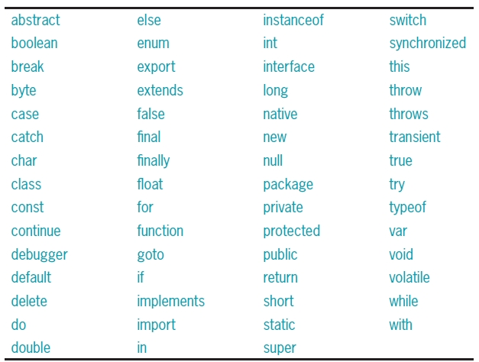
Assigning Variable Names (cont’d.)
Table 1-2 JavaScript reserved words
JavaScript, Fifth Edition

Slide 39
Assigning Variable Names (cont’d.)
Declaring and initializing variables
  Use reserved keyword var to create variables
    Example: var myVariable;
  Initialize variable using the following syntax:
    var variable_name = value;
  Assignment operator: equal sign (=)
    Assigns value on the right side of the expression to the variable on the left side of the expression
  Assigning a literal string value to a variable
    Enclose text in quotation marks
  Can assign the value of one variable to another
JavaScript, Fifth Edition

Slide 40
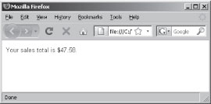
Assigning Variable Names (cont’d.)
Displaying variables: print a variable
  Pass variable name to document.write() or document.writeln()method
  Do not enclose it in quotation marks
Figure 1-8 Results of script that assigns the value of one variable to another
JavaScript, Fifth Edition

Slide 41
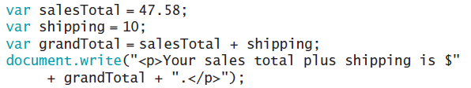
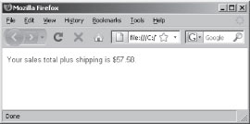
Assigning Variable Names (cont’d.)
Displaying variables (cont’d.)
  Use a plus sign to perform arithmetic operations involving variables containing numeric values
Figure 1-9 Results of script that adds the values of two variables
JavaScript, Fifth Edition

Slide 42
Assigning Variable Names (cont’d.)
Modifying variables
  Change a variable’s value at any point in a script
    Use a statement including the variable’s name
    Followed by an equal sign
    Followed by the value to assign to the variable
JavaScript, Fifth Edition

Slide 43
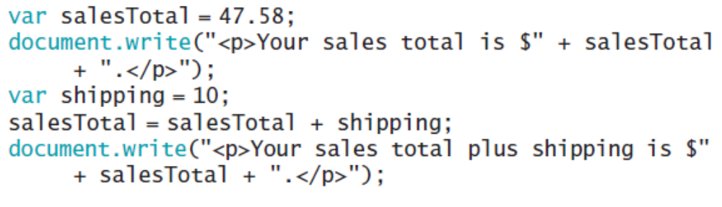
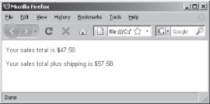
Assigning Variable Names (cont’d.)
Figure 1-10 Results of script that includes a changing variable
JavaScript, Fifth Edition

Slide 44
Building Expressions
Expression
  Literal value or variable or a combination of literal values, variables, operators, and other expressions
    Evaluated by JavaScript interpreter to produce a result
Operands
  Variables and literals contained in an expression
Literal
  Value such as a literal string or a number
Operators
  Symbols used in expressions to manipulate operands
JavaScript, Fifth Edition

Slide 45
Understanding Events
Event
  Specific circumstance monitored by JavaScript
  Script can respond to in some way
  Allows users to interact with Web pages
Common events: actions users perform
Can also monitor events not resulting from user actions
JavaScript, Fifth Edition

Slide 46
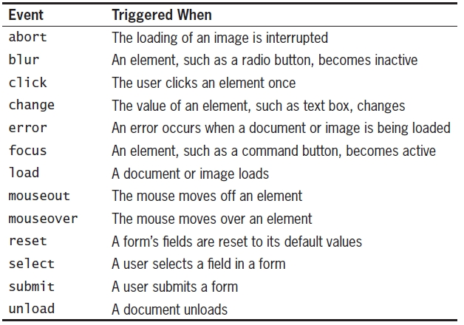
Understanding Events (cont’d.)
Table 1-3 JavaScript events
JavaScript, Fifth Edition

Slide 47
Understanding Events (cont’d.)
Working with elements and events
  Events: associated with XHTML elements
  Event handler
    Code that executes in response to a specific event
  JavaScript code for an event handler
    Contained within the quotation marks following the name of the JavaScript event handler
JavaScript, Fifth Edition

Slide 48
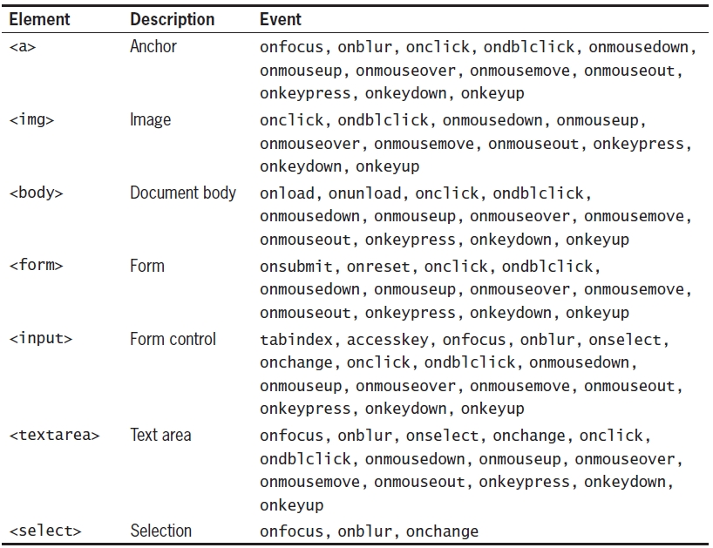
Understanding Events (cont’d.)
Table 1-4 XHTML elements and their associated events
JavaScript, Fifth Edition

Slide 49
Understanding Events (cont’d.)
Referencing Web page elements
  Append element’s name to the name of any elements in which it is nested
    Start with the Document object
  Specific element properties
    Appended to the element name
  Allows for the retrieval of information about an element or the ability to change the values assigned to its attributes
JavaScript, Fifth Edition

Slide 50
Structuring JavaScript Code
Adding JavaScript code to a document
  Must follow certain rules regarding placement and organization of that code
JavaScript, Fifth Edition

Slide 51
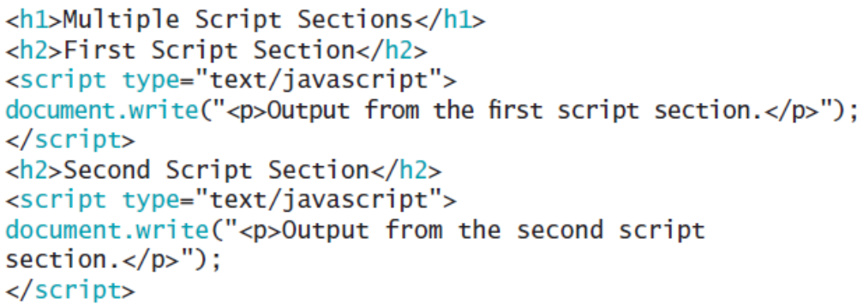
Including a <script> Element for Each Code Section
Can include as many script sections as desired
  Must include a <script> element for each section
  Example code below
    See Figure 1-13 for results
JavaScript, Fifth Edition

Slide 52
Placing JavaScript in the Document Head or Document Body
<script> element placement varies
  Can place in the document head or document body
  Statements in a script
    Rendered in the order in which they appear in the document
  General rule
    Place as much JavaScript code as possible in the document head
    Important if code performs behind-the-scenes tasks required by script sections located in the document body
JavaScript, Fifth Edition

Slide 53
Creating a JavaScript Source File
External file containing JavaScript code
  Usually designated by the .js file extension
    Can legally have any extension
  Contains only JavaScript statements
    No <script> element and no XHTML elements
  Use the src attribute of the <script> element
Advantages
  Neater code; code sharing; ability to hide JavaScript code from incompatible browsers
Can use embedded JavaScript code and JavaScript source files combination
JavaScript, Fifth Edition

Slide 54
Validating Web Pages
Validating parser
  Checks for a well formed Web page
  Verifies document conforms to a specific DTD
Validation
  Process of verifying a well-formed document and checking the elements in your document
Web development tools offer validation capabilities
Validating services found online
  W3C Markup Validation Service:
    http://validator.w3.org
JavaScript, Fifth Edition

Slide 55
Writing Valid JavaScript Code
JavaScript statements contain symbols
  Prevents XHTML document from being well formed
HTML handles successfully
  <script> element statements interpreted as character data
  Character data (CDATA)
    Section of a document not interpreted as markup
XHTML documents
  <script> element statements interpreted as markup
    Parsed character data (PCDATA)
JavaScript, Fifth Edition

Slide 56

Writing Valid JavaScript Code (cont’d.)
JavaScript code in an XHTML document
  Treated as PCDATA
    Validation fails
Two options to resolve validation issue
  Move code into a source file
  Keep JavaScript code within the document
    Enclose code within a <script> element within a CDATA
JavaScript, Fifth Edition

Slide 57
Summary
Hypertext linking: allows quick opening of Web pages
HTML replaced by XHTML replaced by HTML5
Web built on a two-tier client/server system
JavaScript programming language allows for interactive Web pages and sites
  <script> element tells Web browser to interpret the commands it contains
  Can save JavaScript code in a source file
Validating parser verifies a Web page
JavaScript, Fifth Edition

